Slide 1
IMAGE AND VIDEO PROCESSING
INTRODUCTION
Dr. Priya G L
Department of CSE
School of Engineering
Shiv Nadar University Chennai

Slide 2
What is an Image?

Slide 3
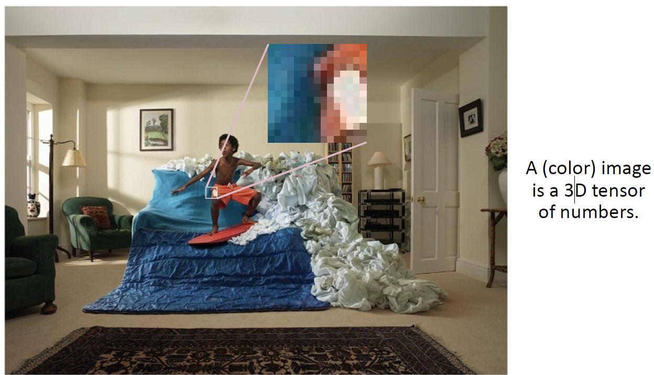
What is an Image?

Slide 4
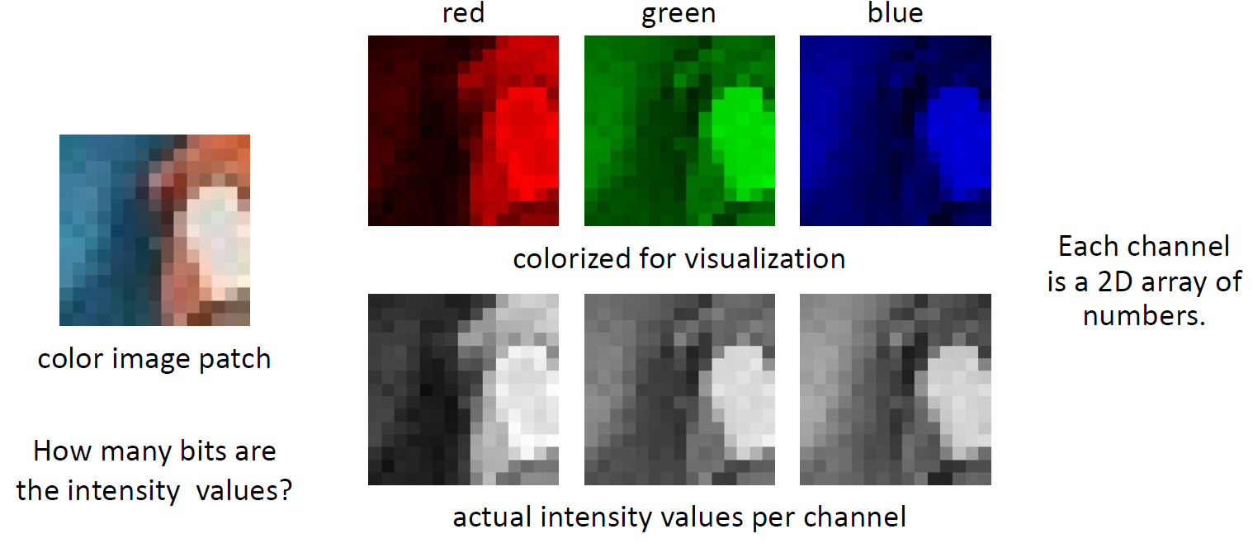
What is an Image?

Slide 5
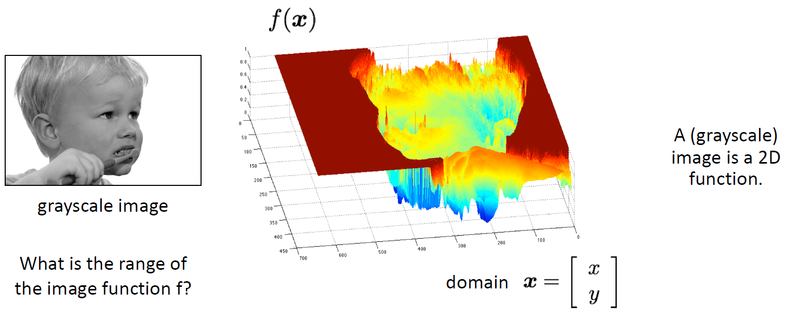
What is an Image?

Slide 6
Image Processing
– a discipline in which both the input and output of a process are images
- limiting and artificial boundary
- Eg: under this definition computing average intensity of an image (output is a number) cannot be considered as image processing task.
Computer Vision
– ultimate goal is to use computers to emulate human vision
- including learning and being able to make inferences and take actions based on visual inputs.
No clear cut boundaries in the continuum from image processing at one end to computer vision at the other end.

Slide 7
Low-level Processes:
Primitive operations such as image pre-processing to reduce noise, contrast enhancement, image sharpening etc.
Both inputs and outputs are images.
Mid-level Processes:
Segmentation, description of segments and classification of segments
Inputs are images
Outputs are attributes extracted from input images (eg. Edges, contours, identity of individual objects).
High-level Processes:
making sense of an ensemble of recognized objects
Performing cognitive functions normally associated with vision

Slide 8
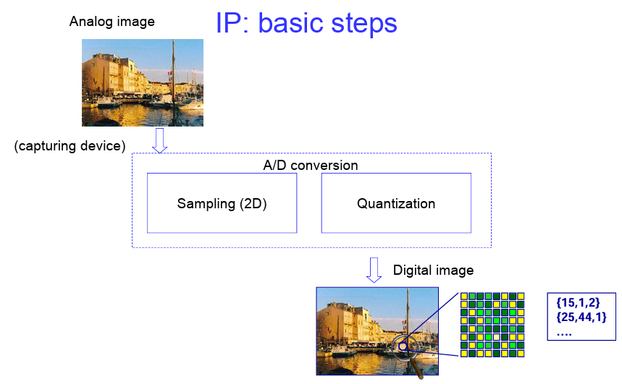
Fundamentals of Image Formation

Slide 9
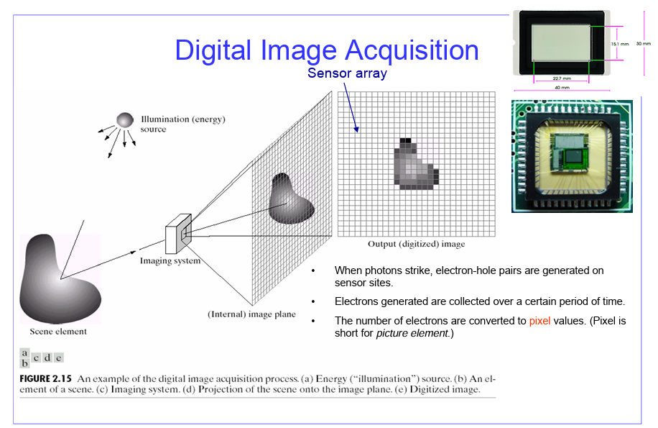

Slide 10
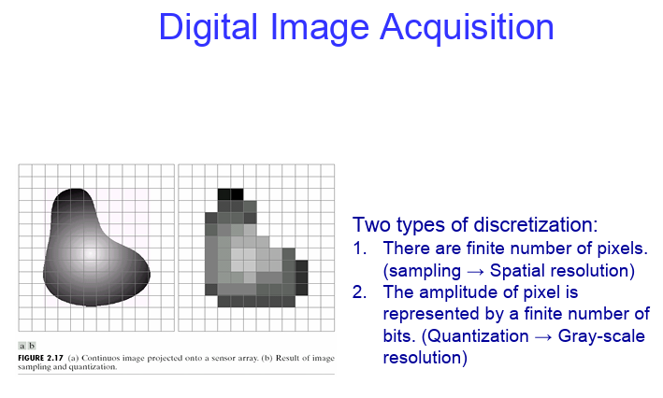

Slide 11
